Slide 1


www.ncepod.org.uk
#acuteNIV

Slide 2

Neil Smith
Method

Slide 3
Study aim
Study aim
To identify and explore avoidable and remediable factors in the process of care for patients treated acutely with non-invasive ventilation

Slide 4
Study objectives
Study aim
Prompt recognition of ventilatory failure and rapid initiation of NIV
Appropriate documentation and management of ventilator settings
Escalation of treatment decisions and planning including admission to critical care
Organisational aspects of care delivery for NIV

Slide 5
Study population inclusion criteria
Study aim
Patients aged 16 years or older who were admitted as an emergency between 1st February 2015 and 31st March 2015 inclusive, and who received NIV acutely
Patients were excluded if they were
  Already on long-term NIV treatment at home
  Received CPAP and not NIV
  (both have the same OPCS code)

Slide 6
Data collection
Study aim
Patient identifier spreadsheet
Clinician questionnaire
Case notes/peer review
Organisational questionnaire

Slide 7
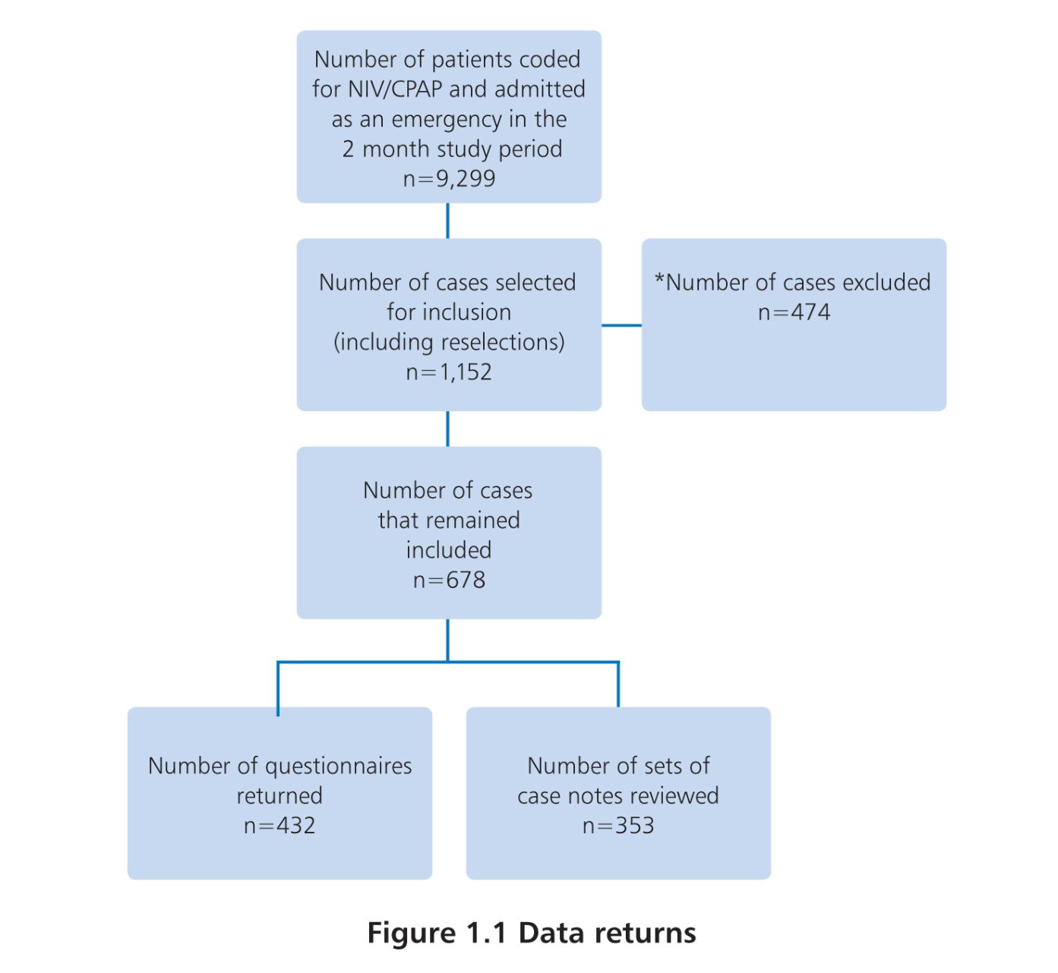
Data returns
Study aim

Slide 8
Clinical coding recommendation
Study aim
Continuous positive airways pressure (CPAP) and
non-invasive ventilation (NIV) should be coded separately. They are two distinct treatments given for different conditions and separate coding will reduce clinical confusion and improve reporting of outcomes.

Slide 9
Gemma Ellis
Sample population &
Initial management

Slide 10
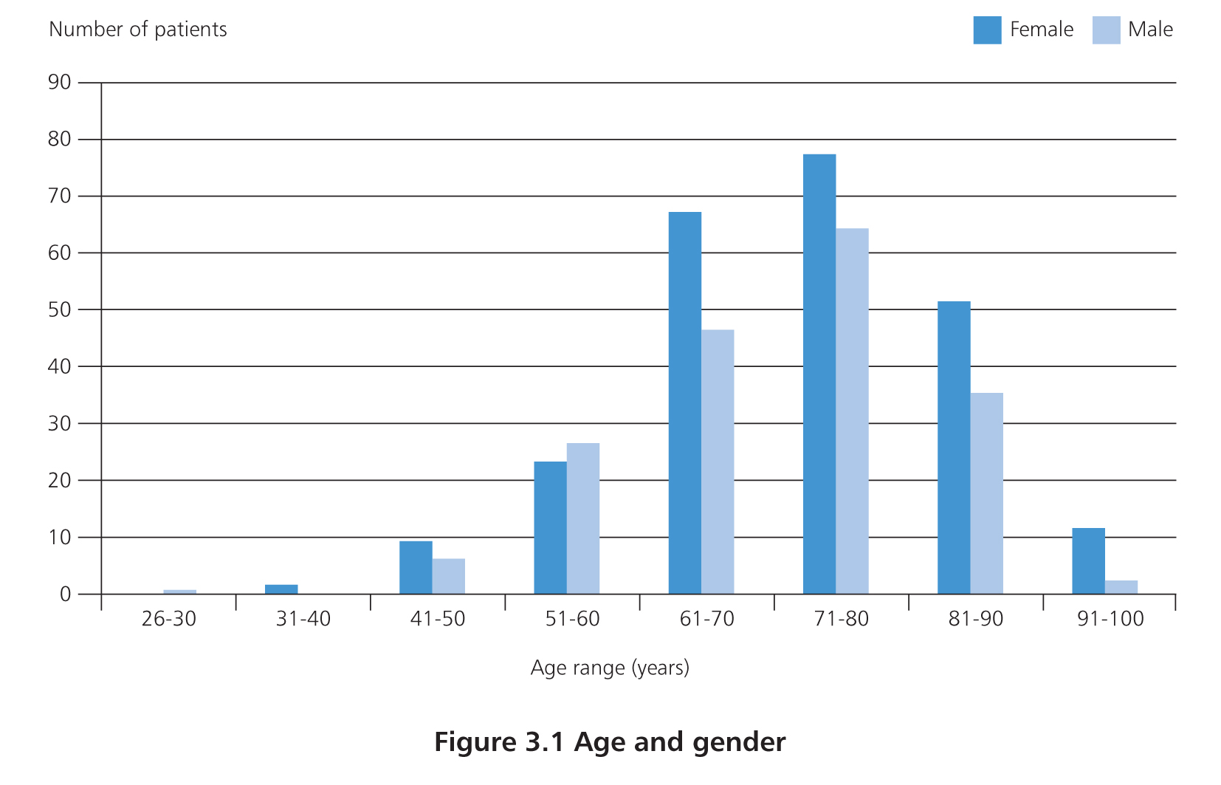
Sample population
Male: 43.1% / age 71.1
Female: 56.9% / age 72.3
ED: 81.5% (270/421 by ambulance)
GP: 55
OPD: 4

Slide 11
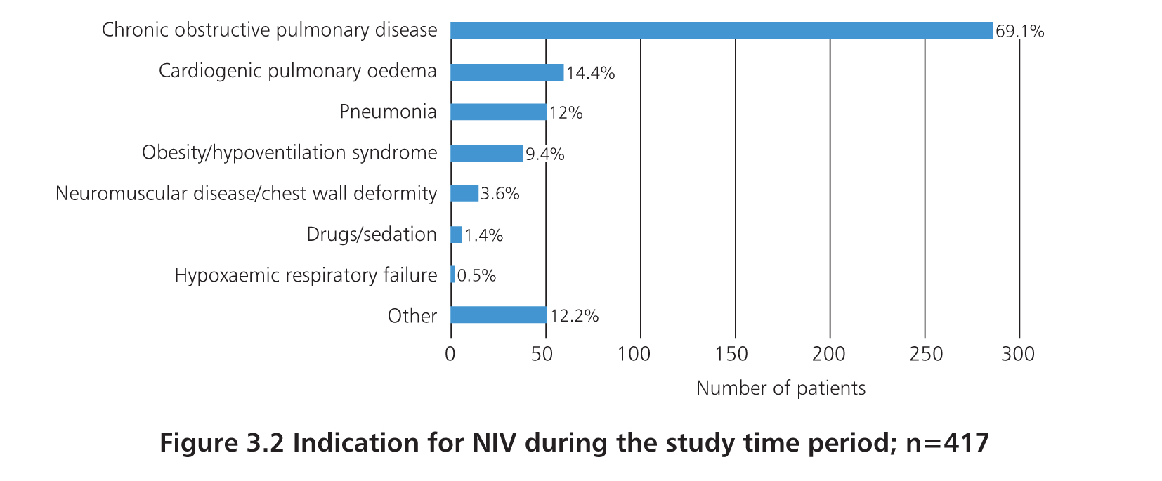
Sample population
COPD: 70%
Cardiogenic PO: 9.6%
Obesity hypoventilation: 8.6%
NIV for pneumonia 50 patients (12%)
20% previous NIV episode

Slide 12
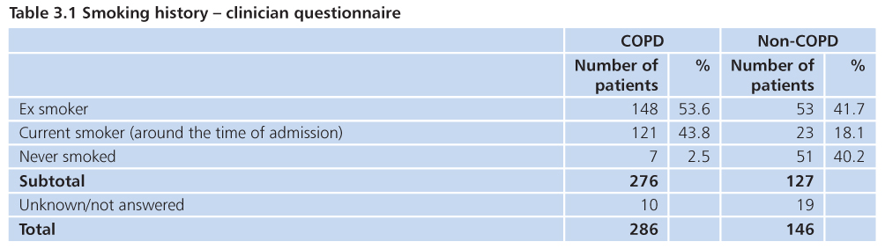
Sample population
COPD: 97.5% current or ex smokers
Non COPD: 23 (18%) current smokers
UK adult smoking rates: 19%

Slide 13
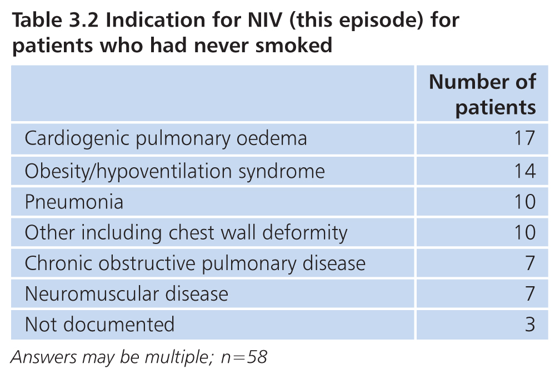
Sample population
14.4% never smoked

Slide 14
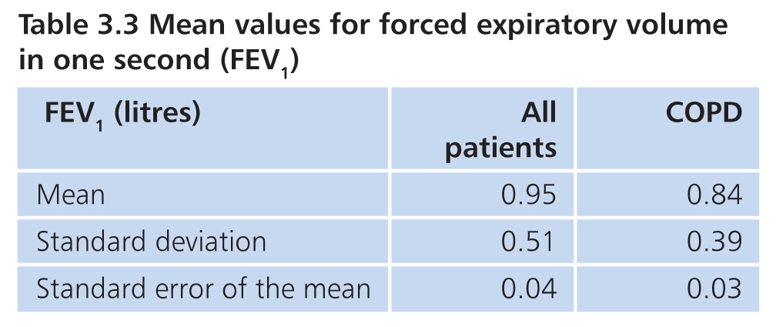
Sample population
LF tests available for 162 patients
129/162 patients had COPD

Slide 15
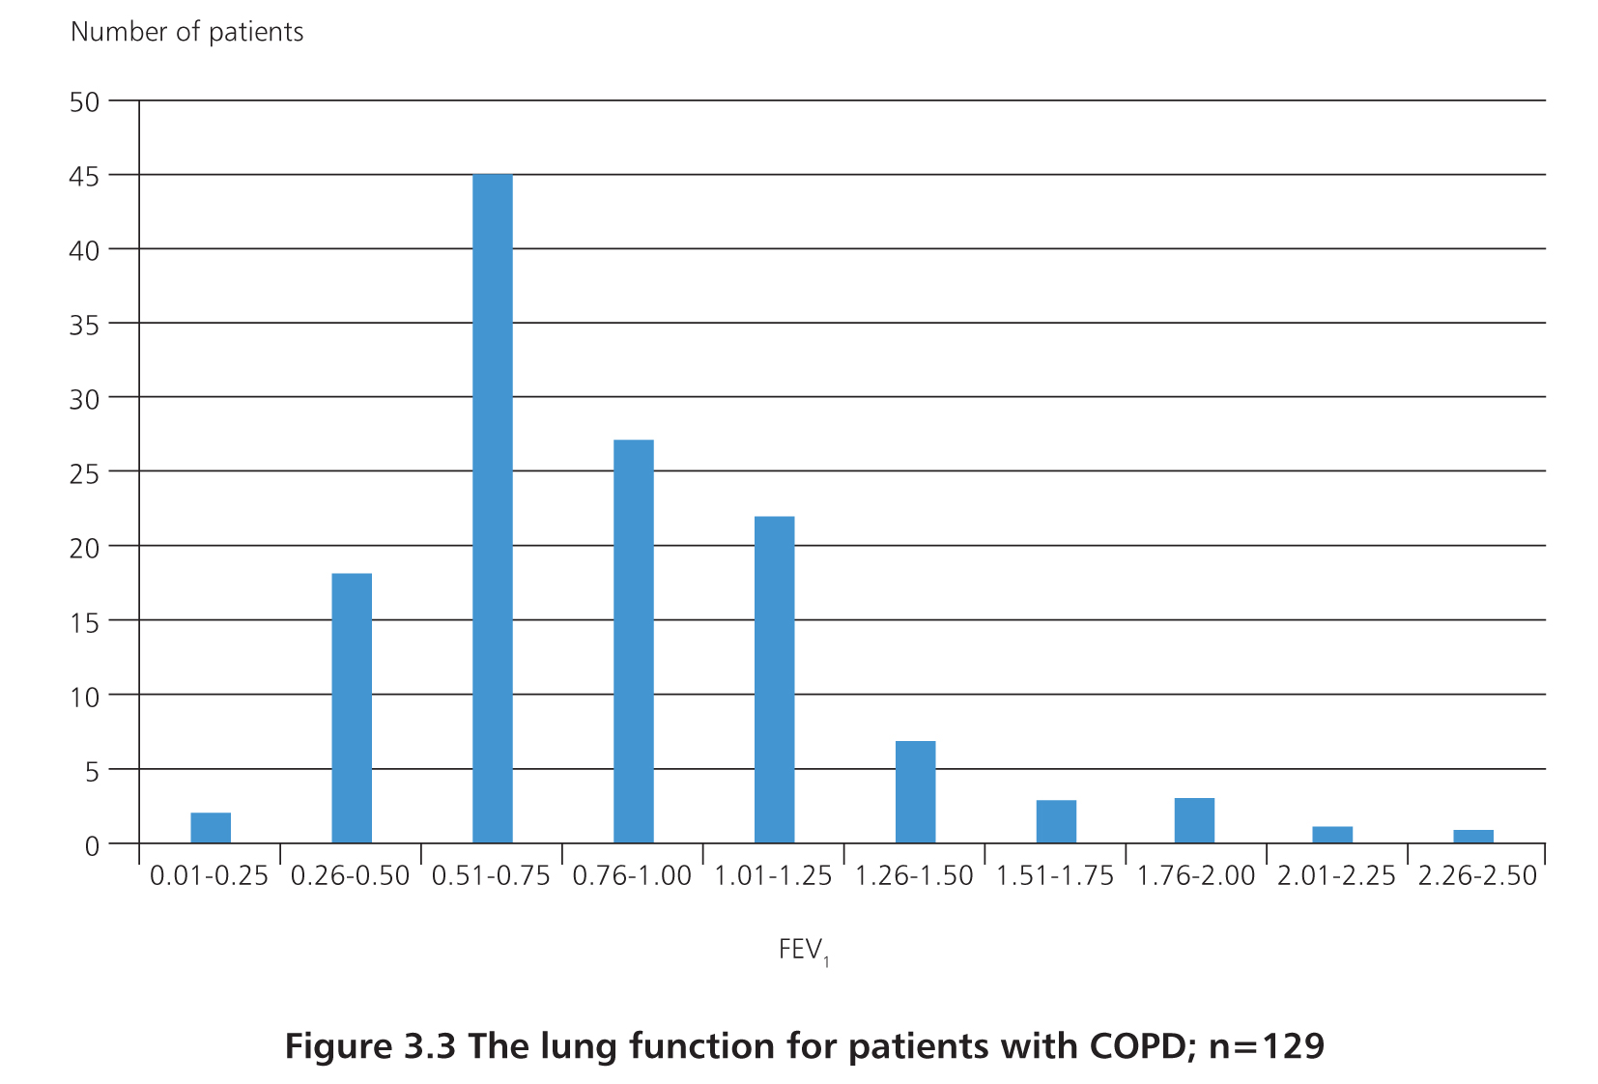
Sample population

Slide 16
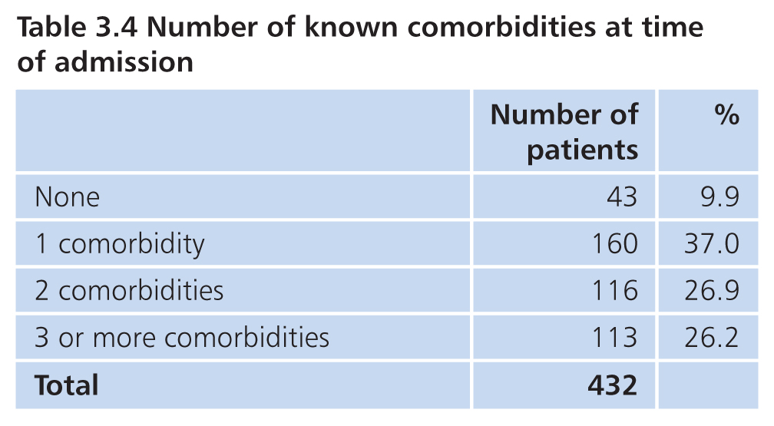
Sample population
389/432 patients with a co-morbidity
53.1% of patients had 2 or more

Slide 17
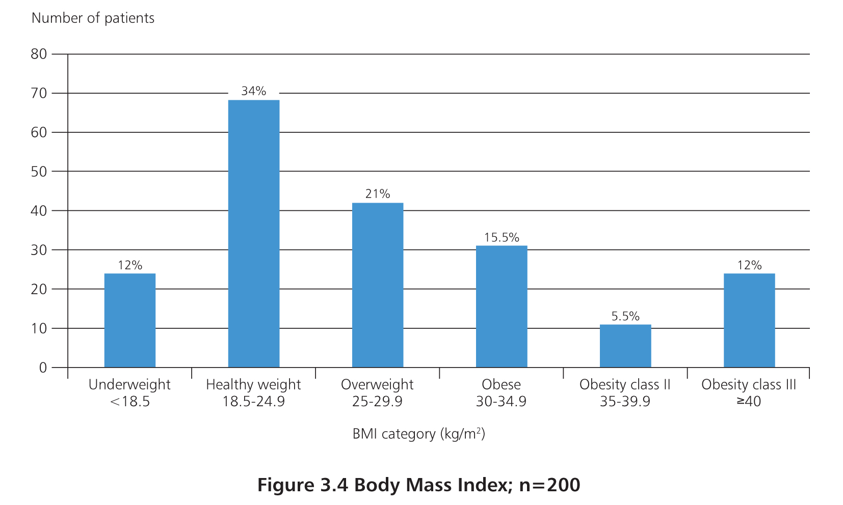
Sample population
Average BMI 27.4
54% BMI > 24.9
Obesity hypoventilation in 9.4% of patients with BMI average of 39.3

Slide 18
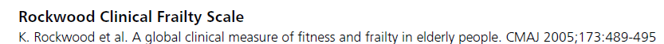
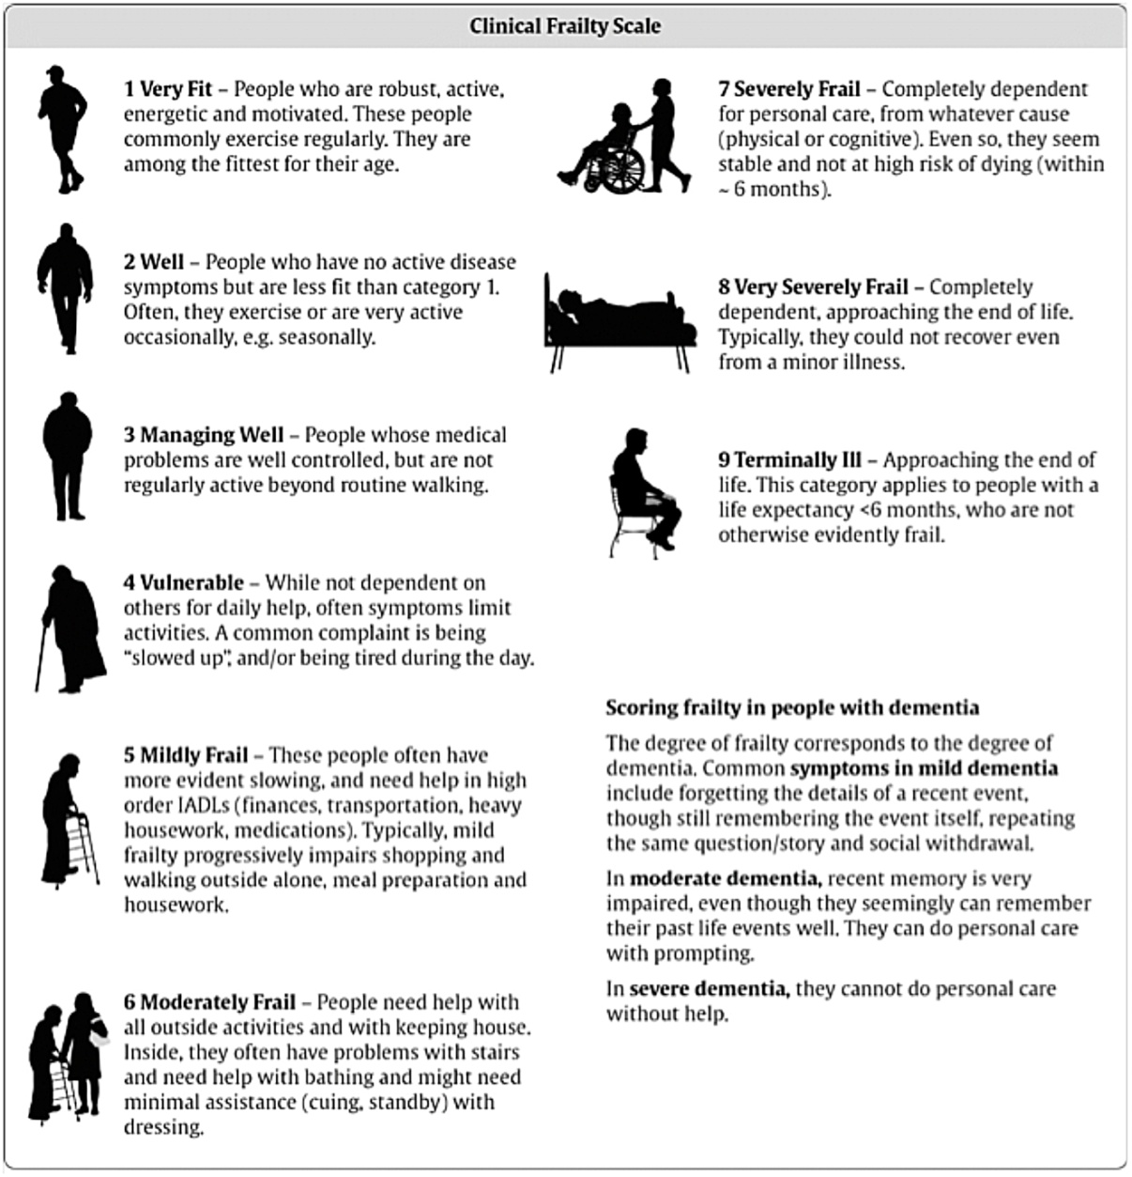
Sample population

Slide 19
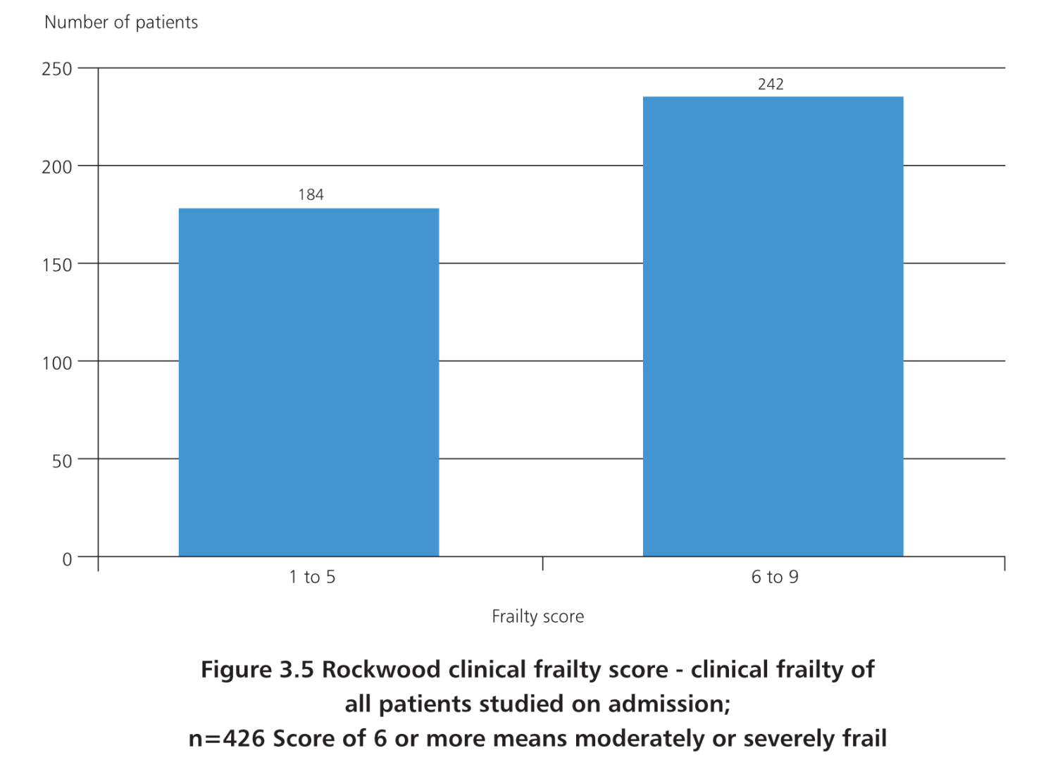
Sample population
CFS 426/432 patients
Clinicians and reviewers same score in 70.3%

Slide 20
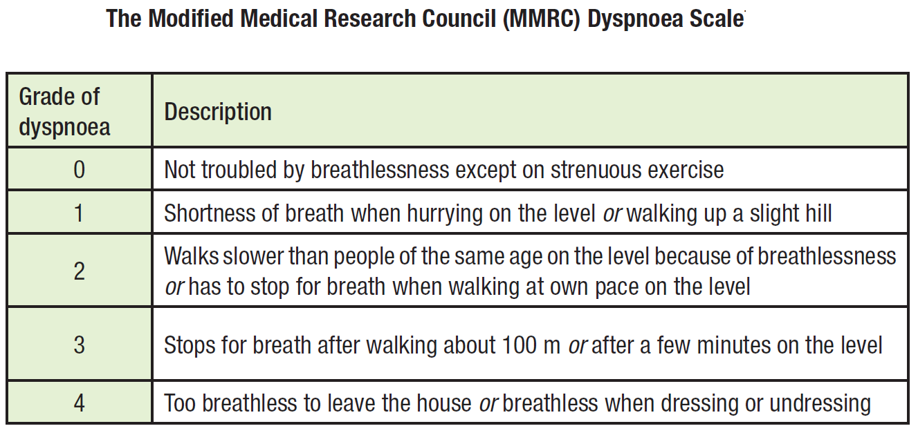
Sample population

Slide 21
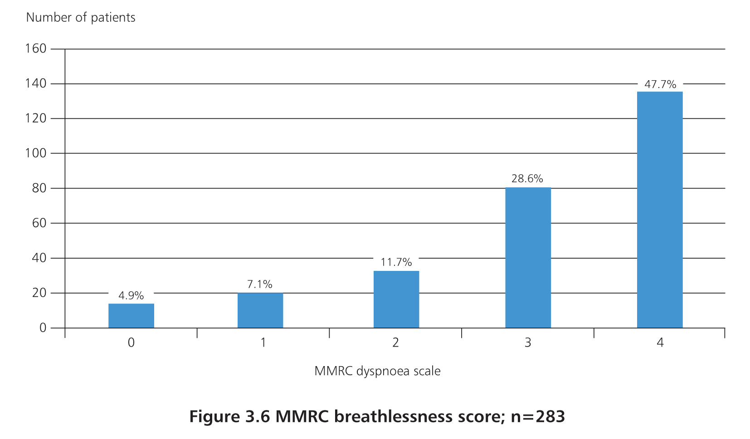
Sample population
MMRC documented in 41 patients
Estimated in 242/391 cases reviewed
Over 3/4 had MMRC of 3 or 4

Slide 22

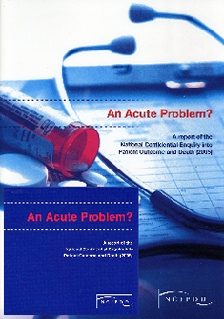
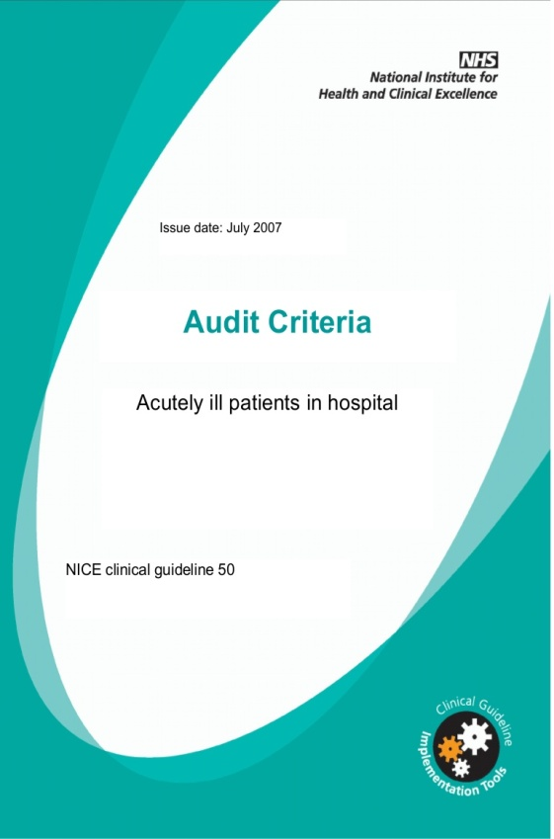
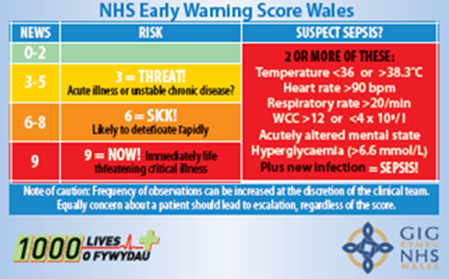
Initial management

Slide 23
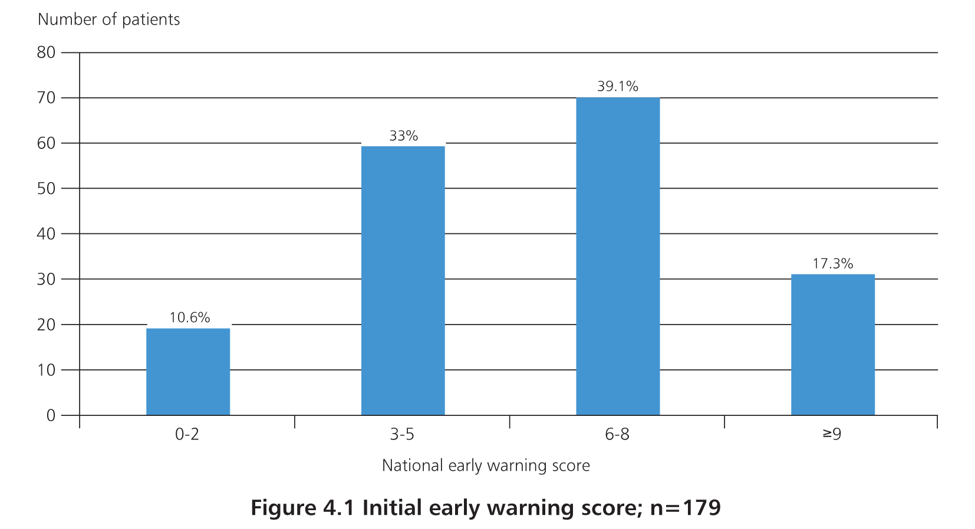
Initial management
EWS not used in 159/338 (47%)
EWS of 6 or more in 56.4%
EWS 9 or more in 17.3%

Slide 24
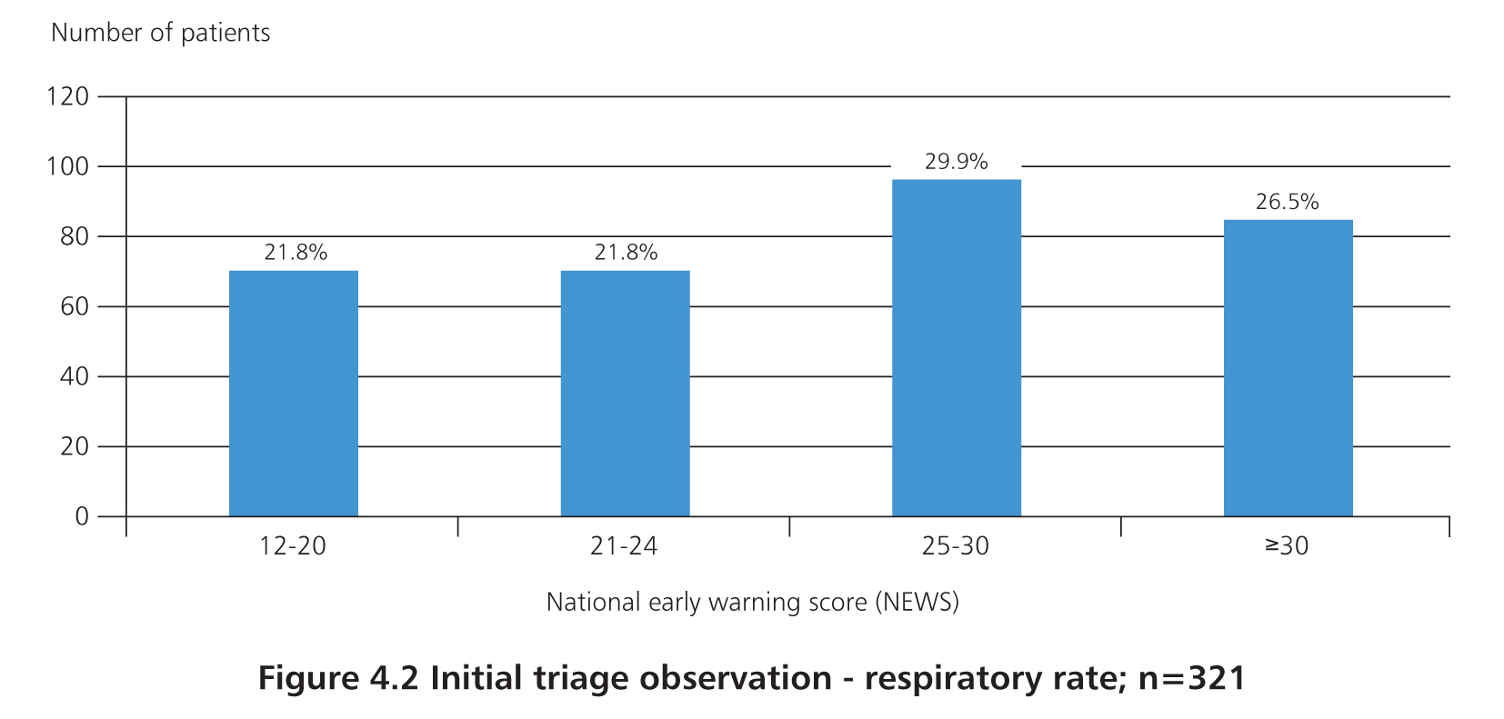
Initial management
Respiratory rate documented in 321 cases reviewed
78.2% patients had a RR of 20 or more
56.4% patients had a RR of 25 or more

Slide 25
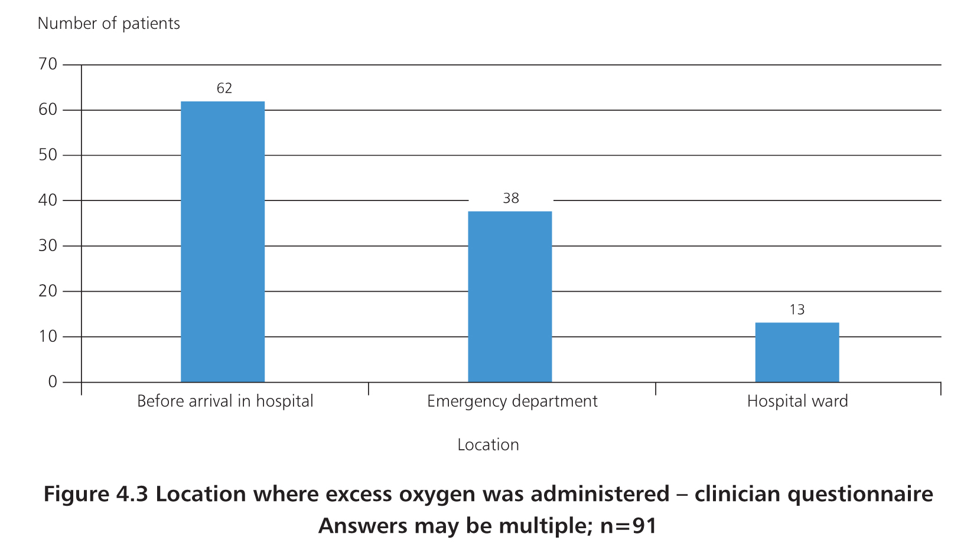
Initial management

Slide 26
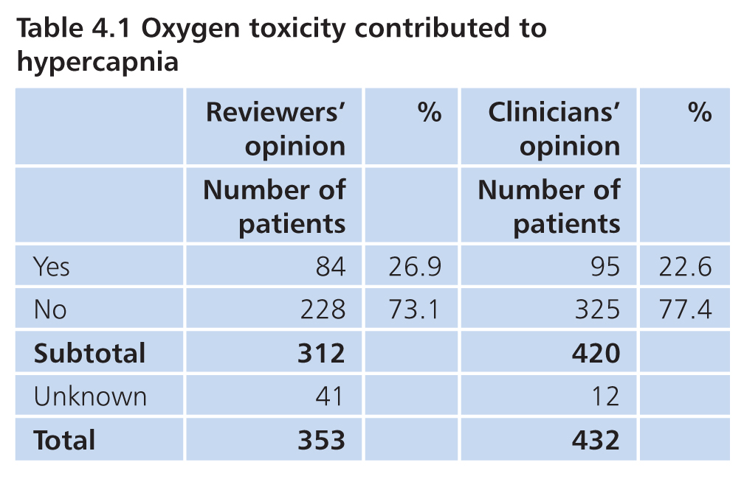
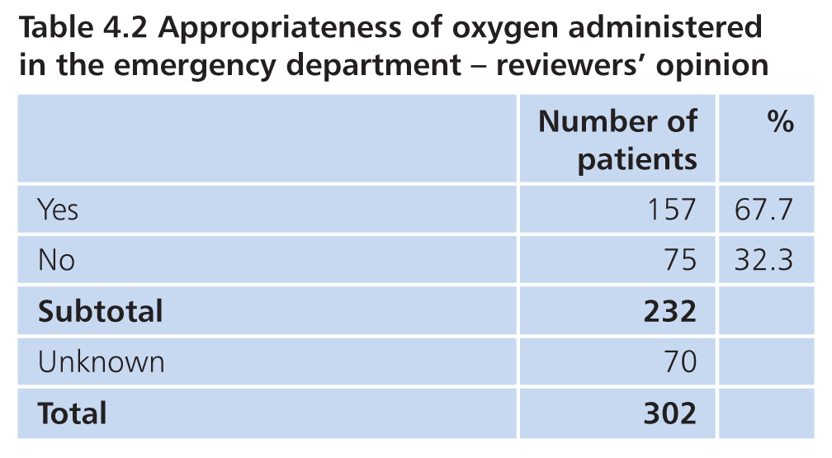
Initial management
BTS: Oxygen toxicity in 17%
NCEPOD: 26.9%

Slide 27
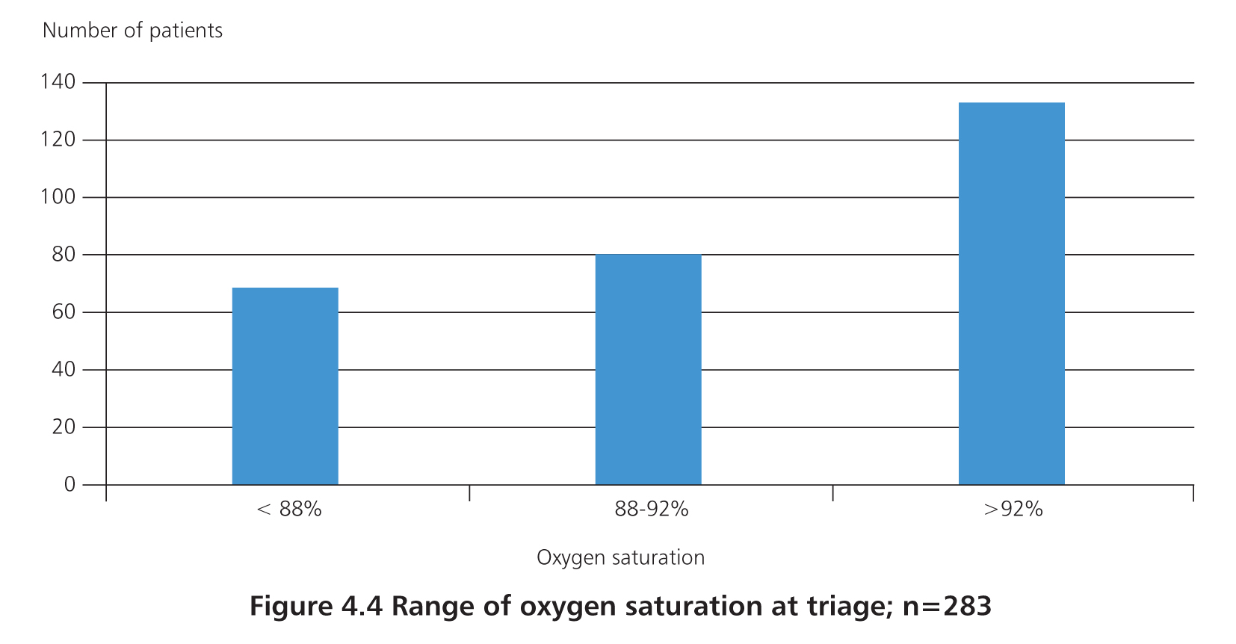
Initial management
88-92 in 28.6%
Below 88 in 24.4%
Above 92 in 47%

Slide 28
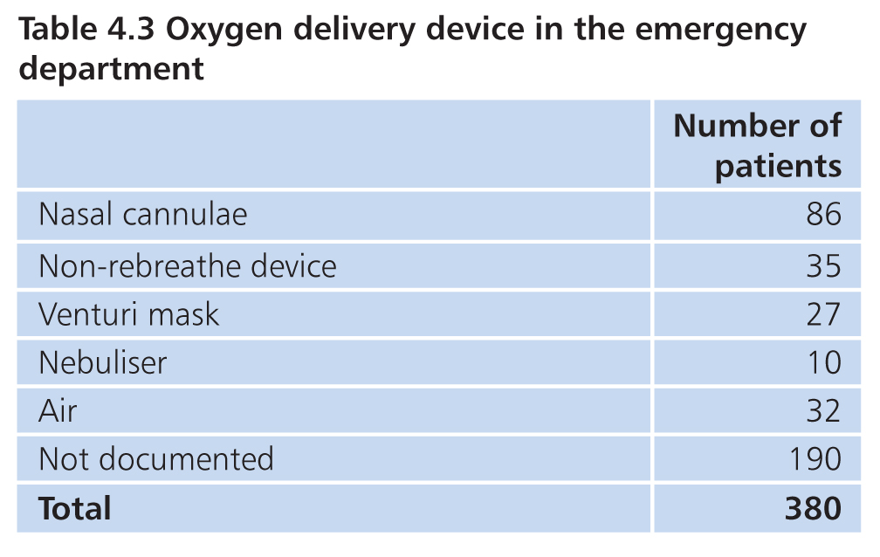
Initial management
158 had method recorded

Slide 29
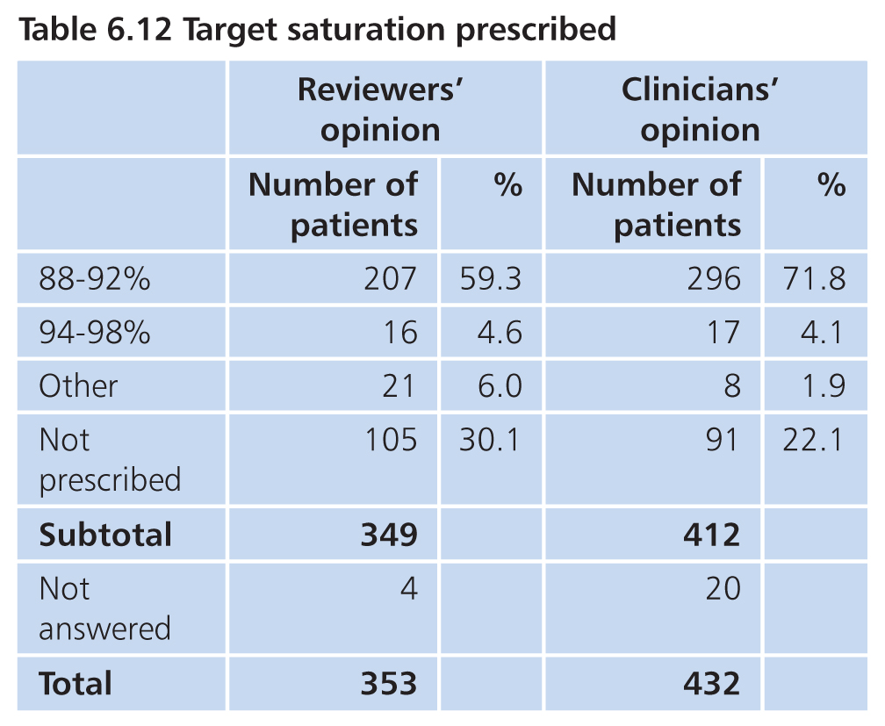
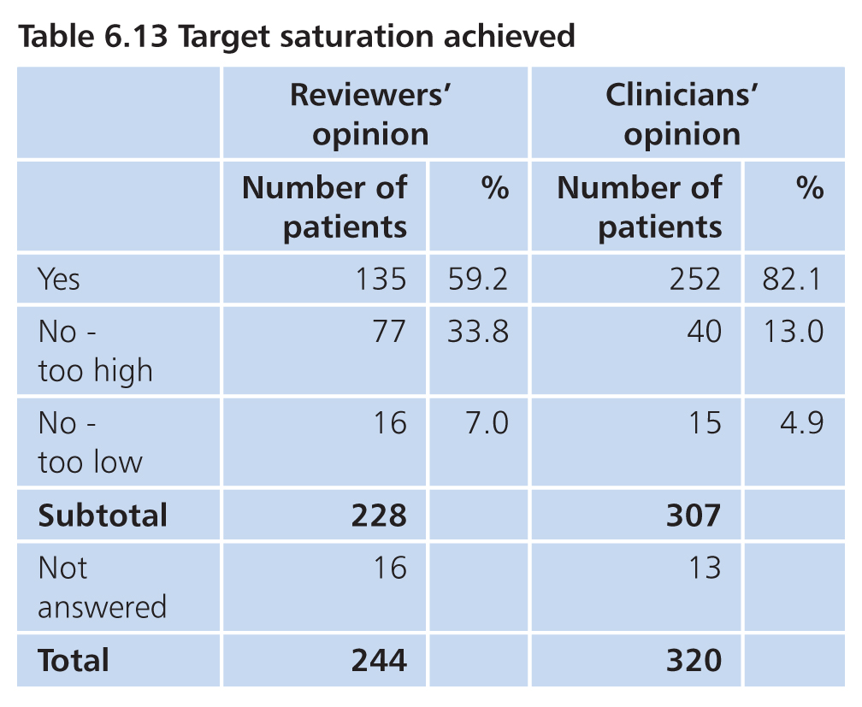
Initial management

Slide 30
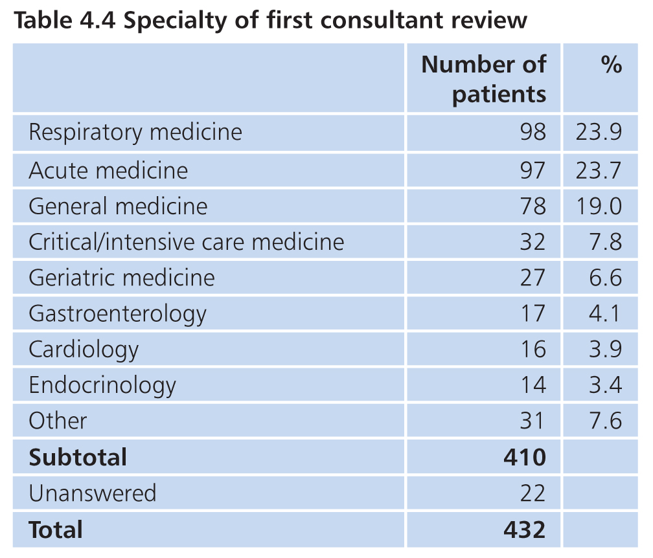
Initial management

Slide 31
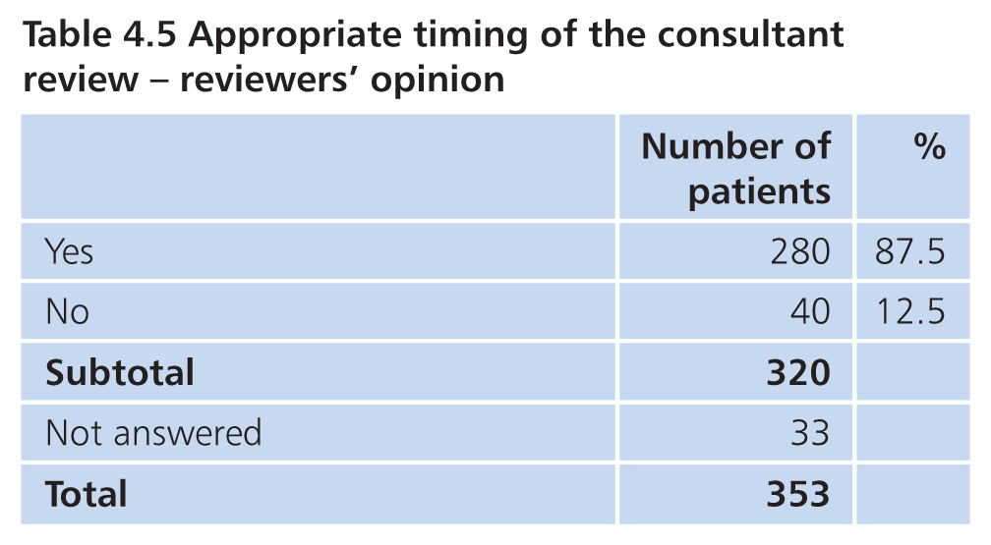
Initial management

Slide 32
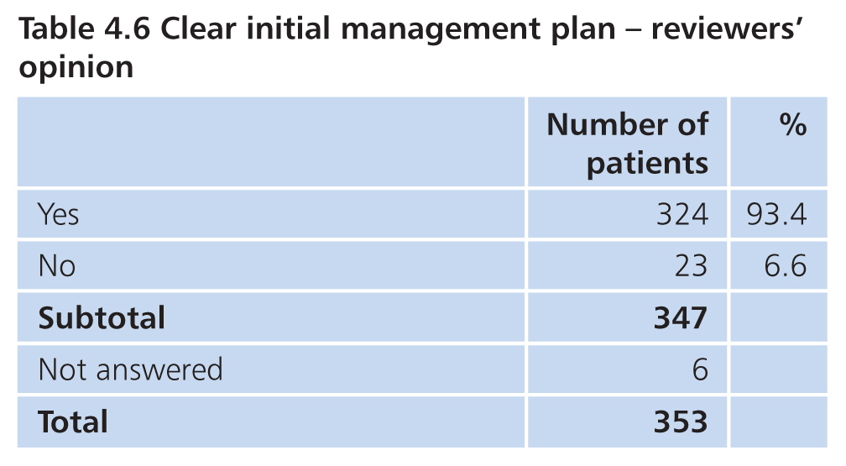
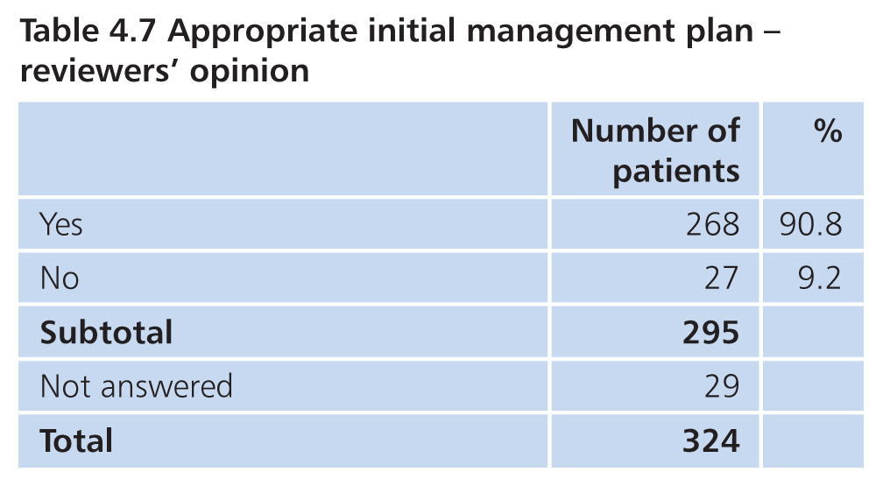
Initial management
14.4% had either no clear initial management plan or an inappropriate one

Slide 33
Mark Juniper
Service organisation

Slide 34
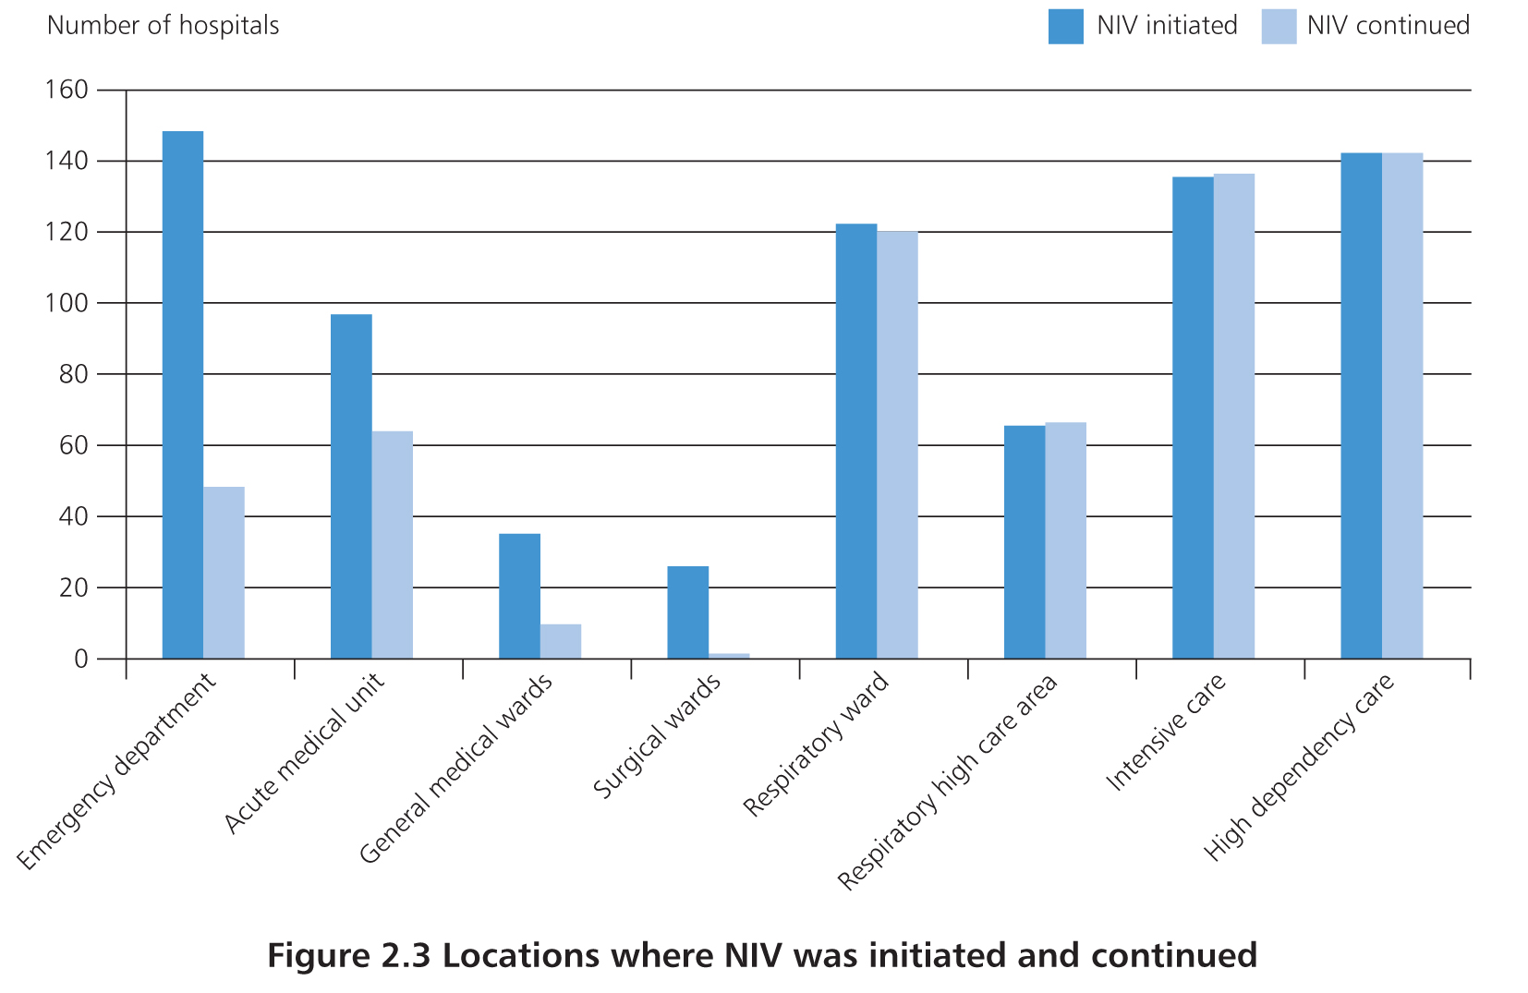
Location of NIV provision
Initiated: acute care areas
Continued: respiratory service/critical care

Slide 35
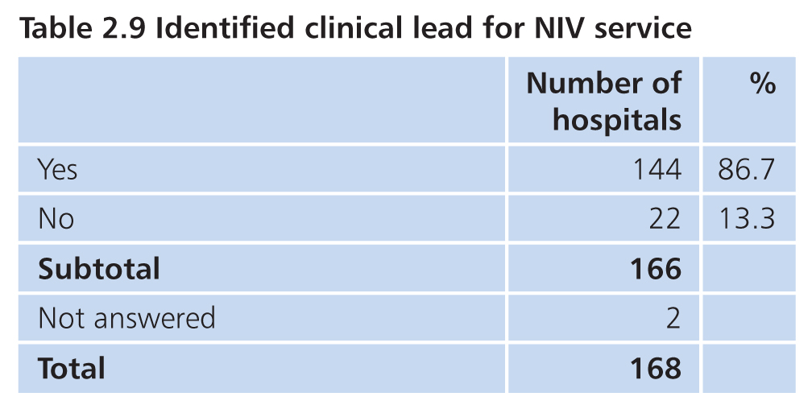
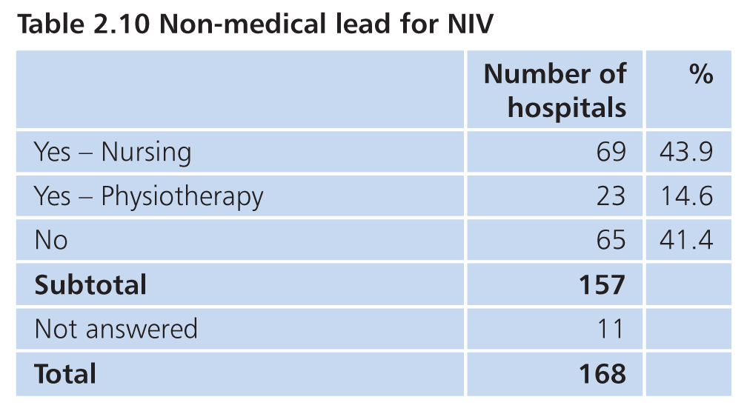
Service organisation
138/140 respiratory consultant
110/133 no time allocated
160/168 (95.2%) hospitals local guideline
140/157 (89.2%) NIV training programme

Slide 36
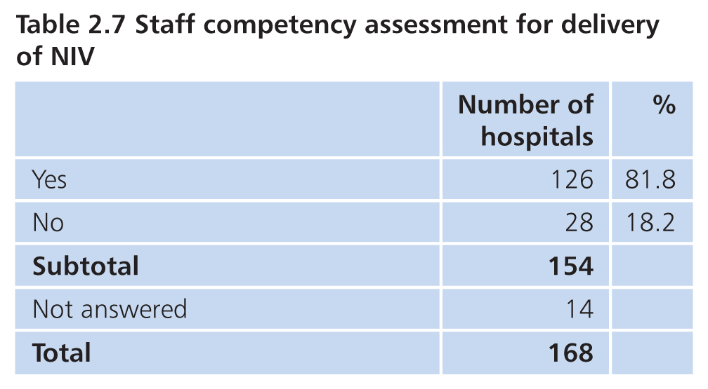
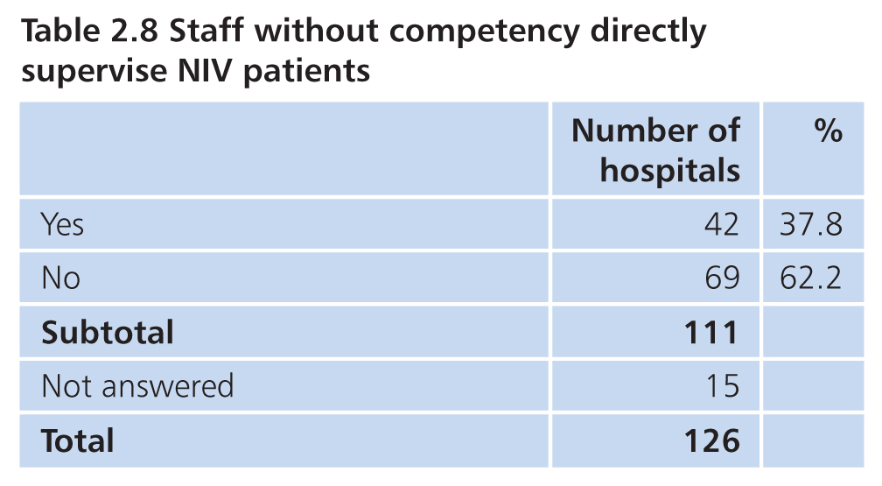
Staffing
‘Designated NIV unit’
79/162 (48.8%) defined ratio of nurses to NIV patients
70/154 (45.4%) staff without defined competency supervise NIV patients

Slide 37
NIV initiation

Slide 38
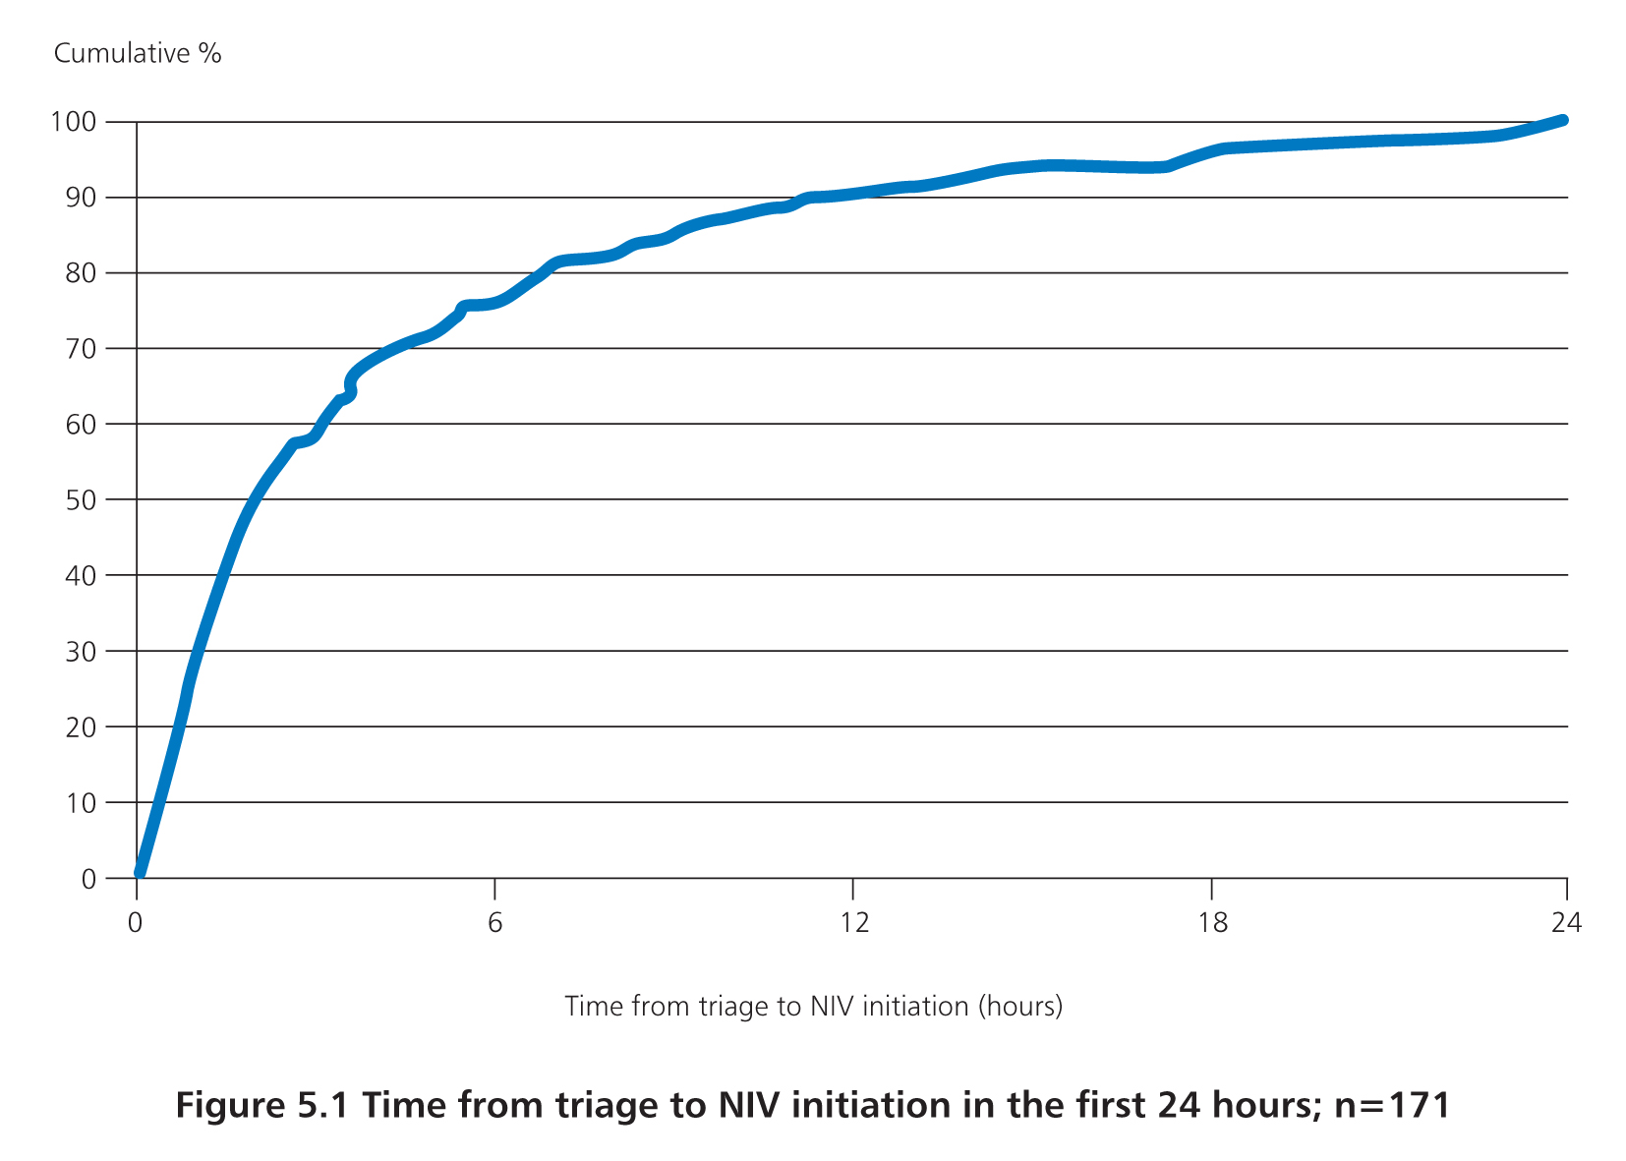
NIV initiation
Triage to NIV | No. (%) of patients (n=242)
< 4 hours | 116 (47.9)
< 8 hours | 140 (57.9)
< 12 hours | 154 (63.6)
< 24 hours | 171 (70.5)
> 24 hours | 71 (29.5)

Slide 39
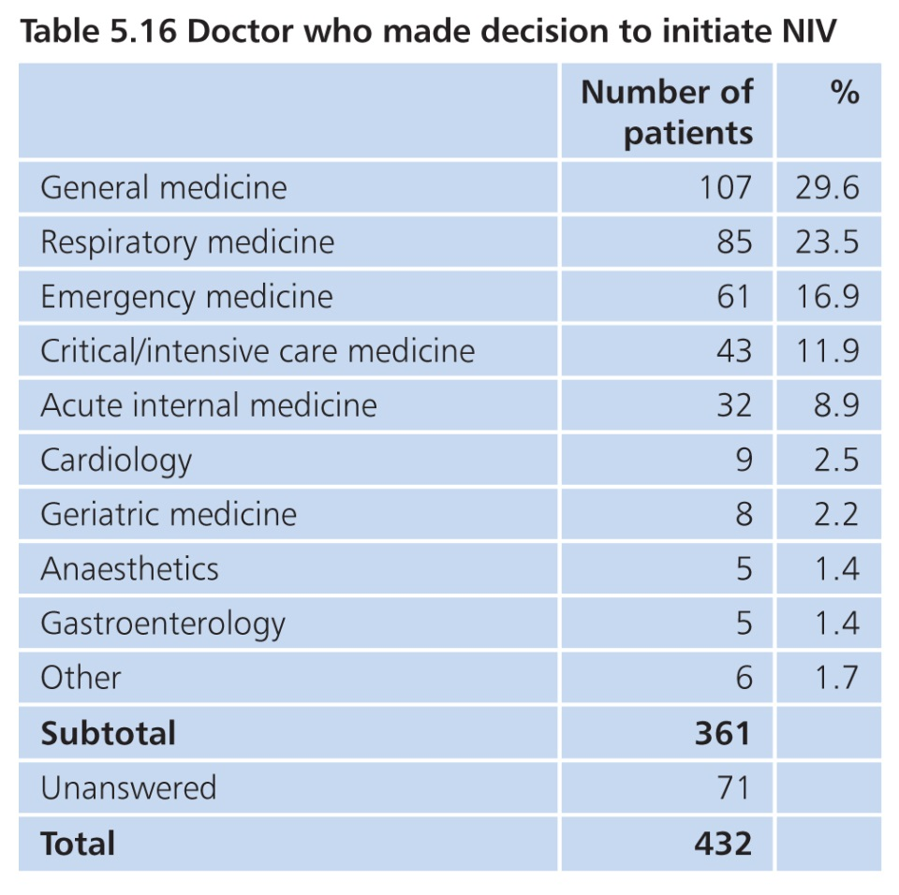
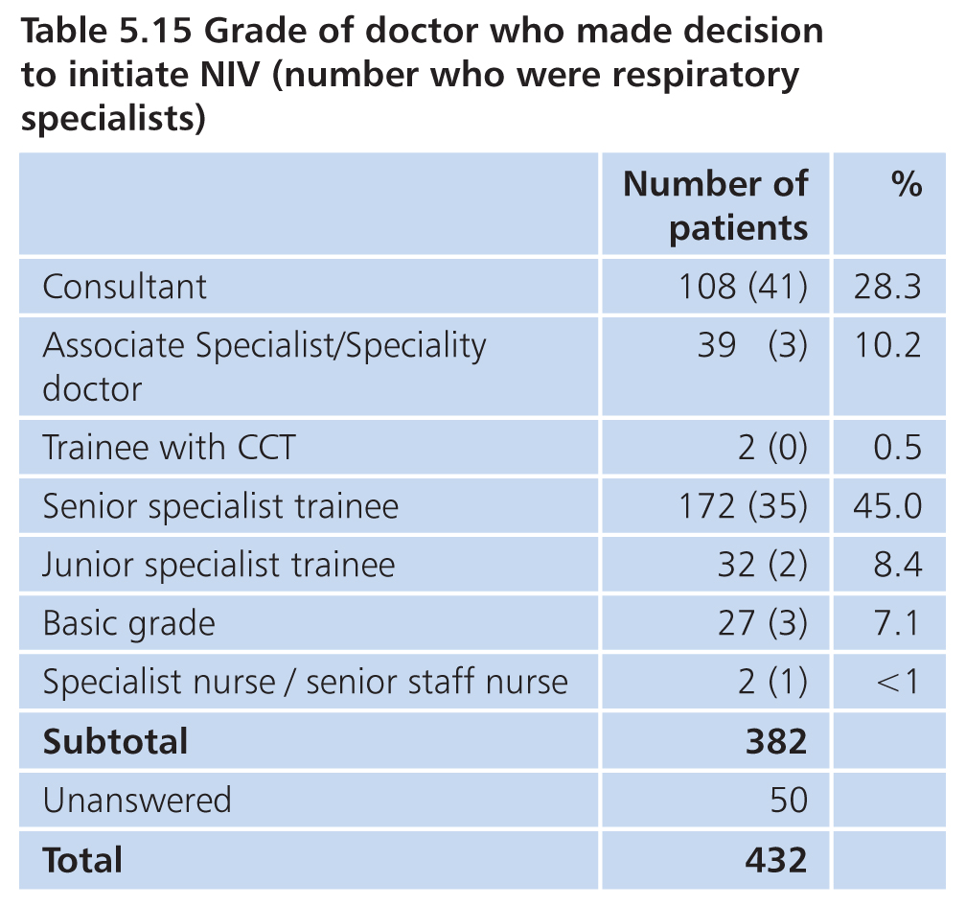
NIV initiation

Slide 40
Case selection
for NIV

Slide 41
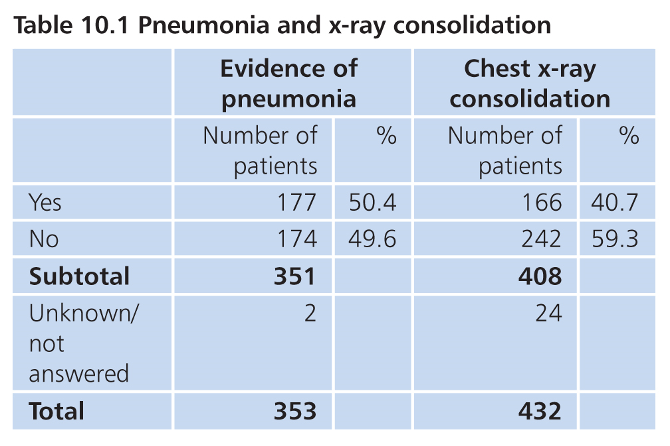
Case selection for NIV
12% primary diagnosis of pneumonia

Slide 42
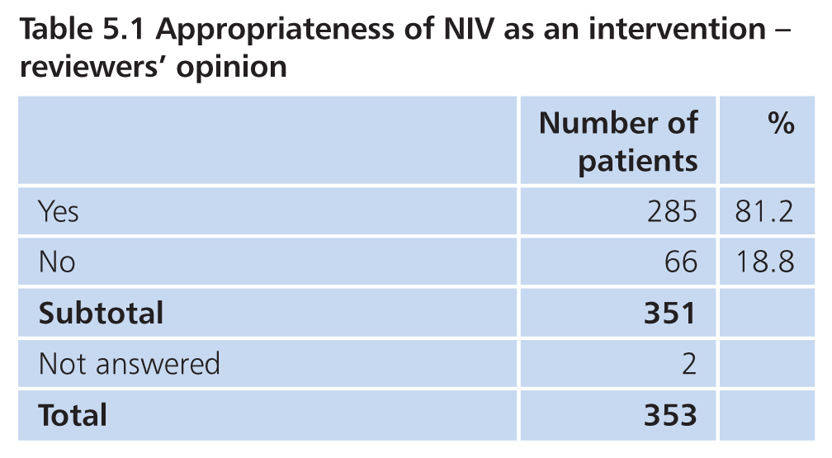
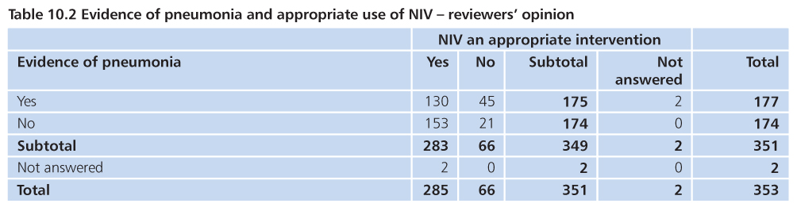
Case selection for NIV

Slide 43
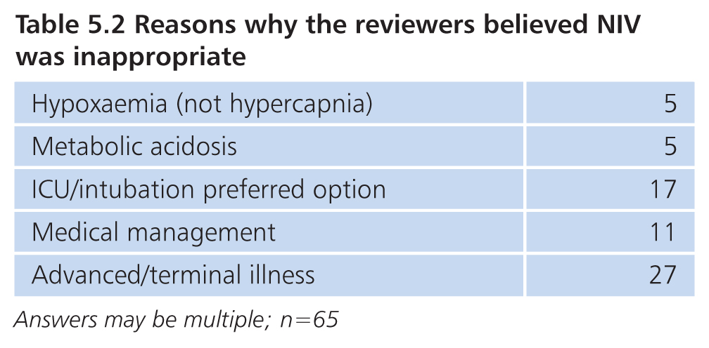
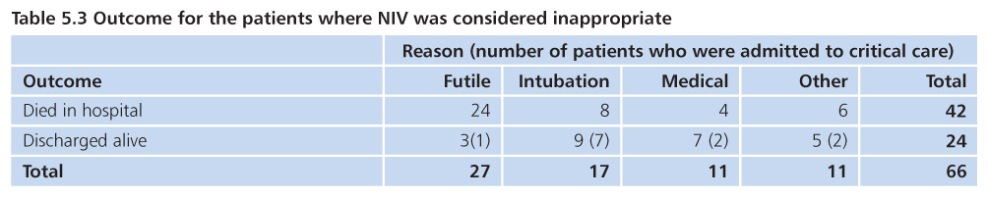
Inappropriate NIV

Slide 44
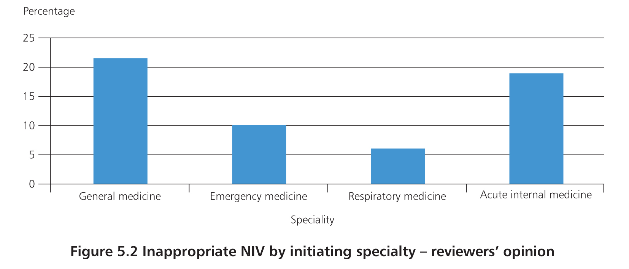
Inappropriate NIV
ITU 15/40 inappropriate as delayed intubation

Slide 45
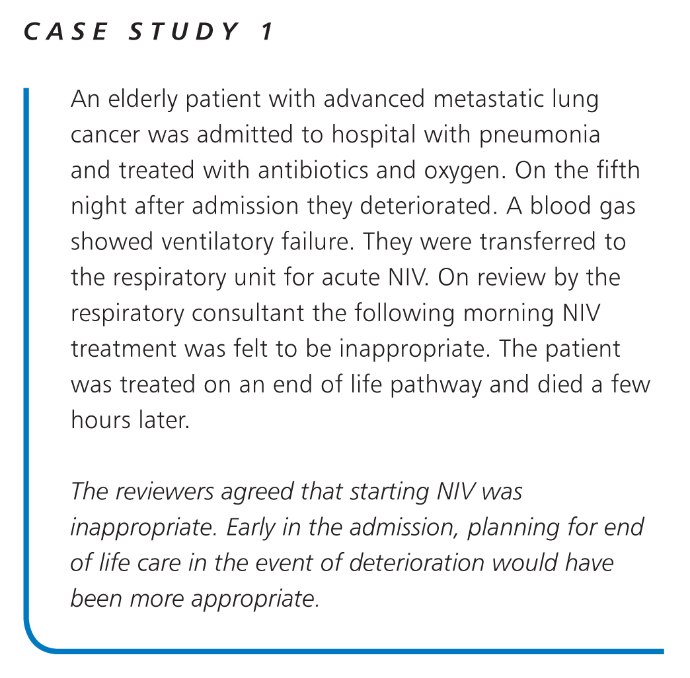

Slide 46
Escalation
planning

Slide 47
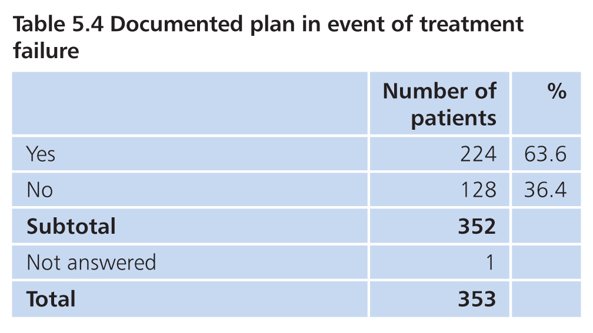
Escalation planning
Plan appropriate in 204/218 (93.6%) cases reviewed

Slide 48
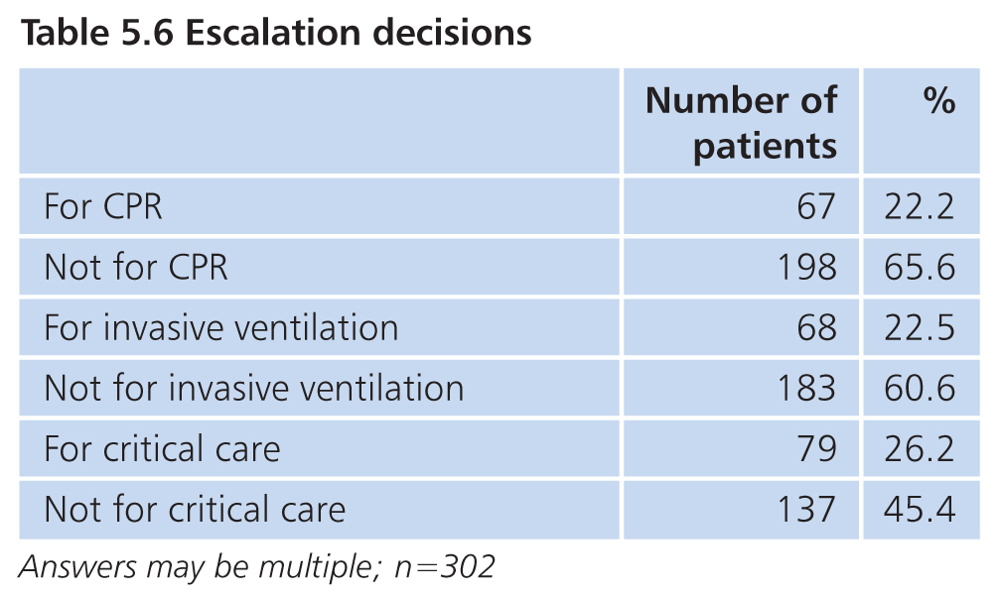
Escalation planning
Plan appropriate in 204/218 (93.6%) cases reviewed

Slide 49
Non-ventilator
management

Slide 50
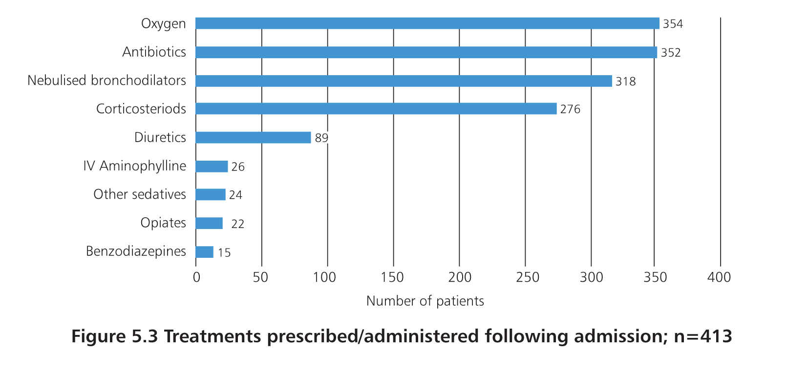
Pre-NIV management

Slide 51
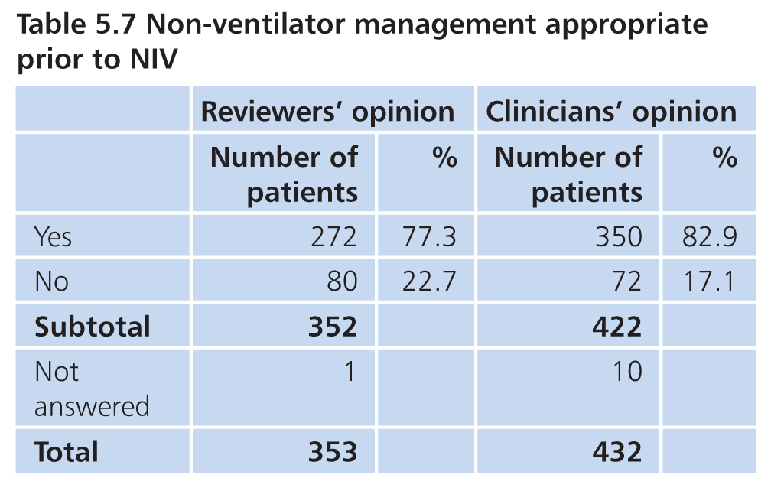
Pre-NIV management
Clinician or reviewer considered potential for improved
non-ventilator management in 103/314 patients (32.8%)

Slide 52
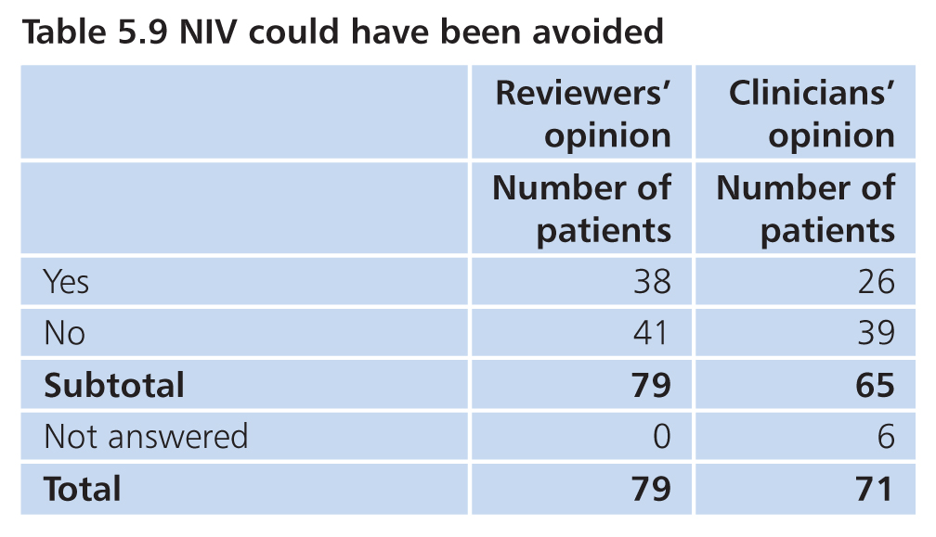
Pre-NIV management

Slide 53


Slide 54
Specialist
review

Slide 55

Specialist review
91/165 (55.2%) hospitals NIV cover out of hours via GIM on call rota
119/158 (75.3%) respiratory cover <50% of rota

Slide 56

Specialist review
Appropriate review in 290/348 (83.3%)

Slide 57

Respiratory specialist review
40 patients respiratory review >72 hours
78.1% NIV before respiratory review

Slide 58


Specialist review

Slide 59

Medical review on NIV

Slide 60
Non-invasive ventilation
episode

Slide 61

Respiratory ward:
214/425 (50.4%)
Critical care: 136/425 (32%)
AMU:
120/425 (28.2%)

Slide 62

Proportion of NIV in clinical areas
101 hospitals
Critical care NIV:
100% in 14
0% in 15
<20% in 63

Slide 63

NIV location

Slide 64
Delay in NIV
treatment

Slide 65

Delay in NIV treatment

Slide 66

Delay in NIV treatment

Slide 67

Delay in NIV treatment

Slide 68


Slide 69
Documentation

Slide 70


Documentation

Slide 71

Documentation

Slide 72


Slide 73
Ventilator
management

Slide 74

Ventilator management

Slide 75

Ventilator management
245/314 (78%) starting EPAP 4 or 5 cmH₂O
16/314 (5.1%) EPAP > 6 cmH₂O

Slide 76

Ventilator management
213/312 (68.3%) starting IPAP 10-15 cmH₂O

Slide 77

Ventilator management

Slide 78

Ventilator management
43/241 (17.8%) highest EPAP > 6 cmH₂O

Slide 79

Ventilator management

Slide 80

Ventilator management
87/353 (24.6%) Highest IPAP not documented
120/266 (45.1%) IPAP below 20 cmH₂O
52/252 (20.6%) no IPAP increase
112/264 (42.4%) inappropriate ventilator management (initial and/or subsequent)

Slide 81


Slide 82

Ventilator management

Slide 83
Monitoring & response
to NIV

Slide 84


Blood gas measurement
Blood gas sampling:
Arterial 97%
Capillary 34%
Venous 22%

Slide 85

Clinical response to NIV

Slide 86

Clinical response to NIV

Slide 87


Clinical response to NIV

Slide 88

Clinical response to NIV

Slide 89



Slide 90


Clinical response to NIV

Slide 91

Clinical response to NIV
Too early:
Not enough time to correct acidosis
Too late:
Improvement, NIV only discontinued on senior review

Slide 92
Monitoring: guidelines
2008 | 2016
Continuous oximetry 12 hours | Continuous oximetry
Continuous ECG 12 hours | ECG if HR >120 / dysrhythmia / cardiomyopathy
pH & CO₂ 1,4,12 hours | Intermittent measurement of pH & CO₂
Clinical 1st hour 15 minutes 1-4 hours 30 minutes 4-12 hours hourly | Clinical No recommendations

Slide 93

Monitoring

Slide 94


Monitoring

Slide 95

Initial physiological abnormalities

Slide 96

Vital signs response to NIV

Slide 97

Vital signs response to NIV

Slide 98

Vital signs response to NIV

Slide 99

Vital signs response to NIV

Slide 100
Deterioration, escalation & critical care

Slide 101


Deterioration on NIV
Action taken in response not appropriate in 33/138 (23.9%)

Slide 102


Critical care referral

Slide 103

Critical care referral
156/328 (47.6%) referred to critical care
pH < 7.26 87/184 (47.3%)
pH ≥ 7.26 92/217 (42.4%)

Slide 104

Frailty and critical care
Frailty commonest reason for not admitting

Slide 105

Critical care admission
103/149 (69.1%) patients admitted
6 patients not admitted may have benefited
7 patients not admitted due to lack of beds

Slide 106

Critical care outcome
66/92 (71.7%) patients discharged alive

Slide 107
Outcomes & assessment
of care

Slide 108

NIV outcome
Overall success 63.7%
Rockwood score | NIV Success
1-5 | 74.2%
6-9 | 55.9%

Slide 109

NIV outcome
Failure predictable in 77/106 (72.6%)
When NIV failure predictable often appropriate

Slide 110


Assessment of NIV care
Room for improvement in ventilator management in 174/288 (60.4%)

Slide 111

Quality of NIV
48.5%
27.5%
19.6%
4.4%
For 342 patients

Slide 112


Mortality

Slide 113

Mortality and initial pH

Slide 114

Mortality: summary

Slide 115
Overall quality of care

Slide 116

Overall quality of care
34.3%
26.5%
19.3%
12.4%
7.5 %

Slide 117
Summary
Effective NIV care is more complex than it appears
In 4 out 5 cases reviewed, care was rated as less than good
Wide organisational variation (staffing and monitoring)
Case selection often inappropriate
Treatment frequently delayed (service organisation, poor recognition)
Ventilator and non-ventilator management often poor

Slide 118
Recommendations

Slide 119
Principal recommendations
All hospitals should have a clinical lead for their acute NIV service. The clinical lead should have time allocated in their job plan with clear objectives, including audit and governance for this service.
Treatment with acute NIV must be started within a maximum of one hour of the blood gas measurement that identified the need for it, regardless of the patient’s location. A service model whereby the NIV machine is taken to the patient to start treatment prior to transfer for ongoing ventilation will improve access to acute NIV.

Slide 120
Principal recommendations
All hospitals where acute NIV is provided must have an operational policy that includes, but is not limited to:
Appropriate clinical areas where acute NIV can be provided, and in those areas the minimum safe level of staff competencies;
Staff to acute NIV ratios;
Escalation of treatment and step down care procedures;
Standardised documentation; and
Minimum frequency of clinical review, and seniority of reviewing clinician
Compliance with this policy should be part of the annual audit process.

Slide 121
Principal recommendations
All patients treated with acute NIV must have a treatment escalation plan in place prior to starting treatment. This should be considered part of the prescription for acute NIV and include plans in relation to:
a) Escalation to critical care;
b) Appropriateness of invasive ventilation; and
c) Ceilings of treatment
This should take into account:
d) The underlying diagnosis
e) The risk of acute NIV failure; and
f) The overall management plan

Slide 122
Principal recommendations
All patients treated with acute NIV must be discussed with a specialist competent in the management of acute NIV at the time treatment is started or at the earliest
opportunity afterwards. Consultant specialist review to plan ongoing treatment should take place within a maximum of 14 hours.

Slide 123
Principal recommendations
All patients treated with acute NIV must have their vital signs recorded at least hourly until the respiratory acidosis has resolved. A standardised approach such as the National Early Warning Score is recommended.
All hospitals should monitor their acute non-invasive ventilation mortality rate and quality of acute NIV care. This should be reported at Board level.

Slide 124
www.ncepod.org.uk
#acuteNIV

